Slide 1


Feeling INDEx
CM3070 – Computer Science Final Project
CM3015 Machine Learning and Neural Networks: Project Idea Title 1: Deep Learning on a public dataset
By Robert de Swardt
Notes:
Welcome to the overview of my project on developing a feeling index for scoring interactions in video conferencing calls.
In this video, I will explain the what I have done to complete this project as well as my findings and conclusion.
describe the implemented features, discuss the algorithms and techniques used,
provide an explanation of the code, showcase visual representations of the product, and evaluate the success and the plans for improvement.

Slide 2

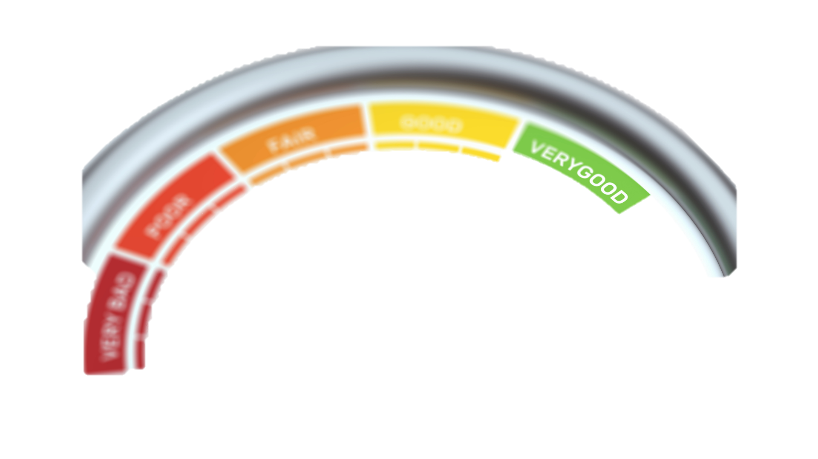
Notes:
The project aims to analyze the emotional dynamics in video conferencing calls. By using sentiment Analysis and Emotional prediction of the speaker in the video.
By extracting facial expressions and performing sentiment analysis, we can generate emotional scores for each participant, giving insights into the overall emotional state of the call.

Slide 3

1. Identify relevant emotions and sentiment categories.
2. Collecting and Pre-processing Data.
3. Facial Emotion Recognition and Sentiment Analysis.
4. Normalizing the Scores.
5. Determining Weights or Importance.
6. Combining Scores into a Composite Index.
7. Validation of the Index Score.
Notes:
In order to achieve this outcome the following needs to be done:
1. Identify relevant emotions and sentiment categories.
2. Collecting and Pre-processing Data. In which I used the FERV39k Dataset.
3. Facial Emotion Recognition and Sentiment Analysis.
4. Normalizing the Scores.
5. Determining Weights or Importance.
6. Combining Scores into a Composite Index.
7. Validation of the Index Score.

Slide 4
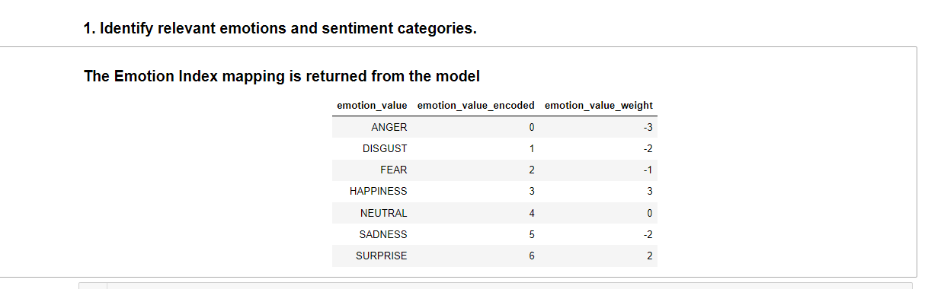
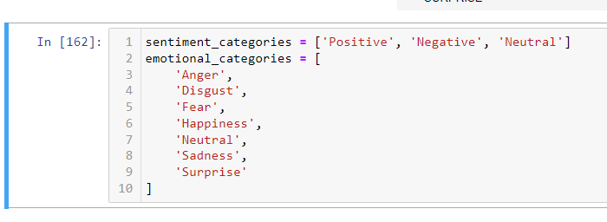
1. Identify relevant emotions and sentiment categories.
Notes:
Identify relevant emotions and sentiment categories.
2. Determining Weights or Importance
Expert judgment is employed to determine the values assigned based on the emotion.
The emotion with the higest score is Happy : 3 The worst sentiment is Negative with a score of -1

Slide 5
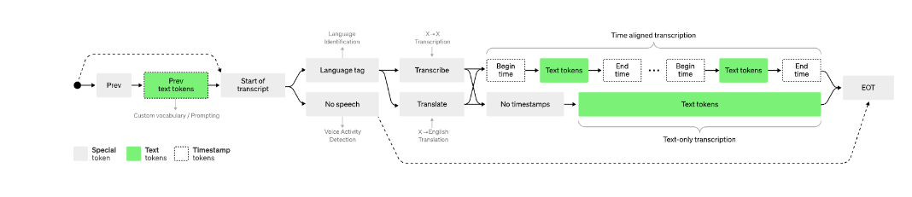
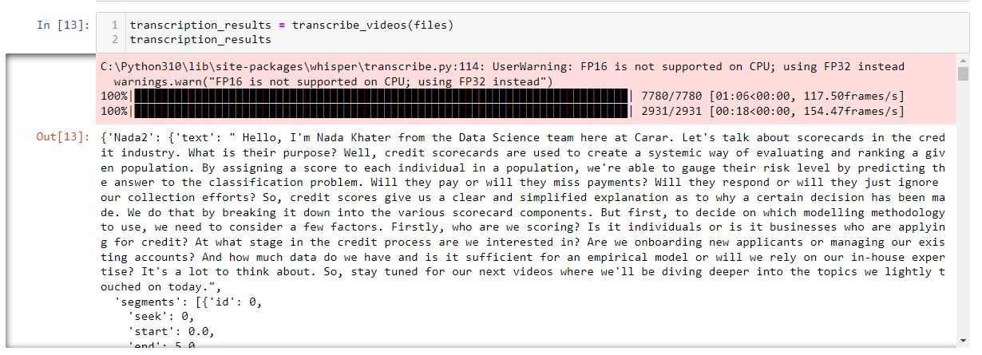
2. Collecting and Pre-processing Data.
Notes:
2. Collecting and Pre-processing Data.
Recorded videos of short duration will be utilized to demonstrate the functionality and accuracy of the approach in determining sentiment and facial recognition.
The extraction of audio from the video and the application of facial recognition will be employed to capture snapshots of the subjects in the video and perform emotional recognition.
Wisper will be employed for video transcription, with each spoken sentence being assigned a timestamp indicating the start and end time within the video. The average timestamp will be used to extract the subject's facial expression at the specified time and analyze it for emotion, assigning a relevant score.
The Open CV library will also be utilized, known for its speed and efficiency, making it a popular choice for real-time applications and performance-critical tasks.

Slide 6
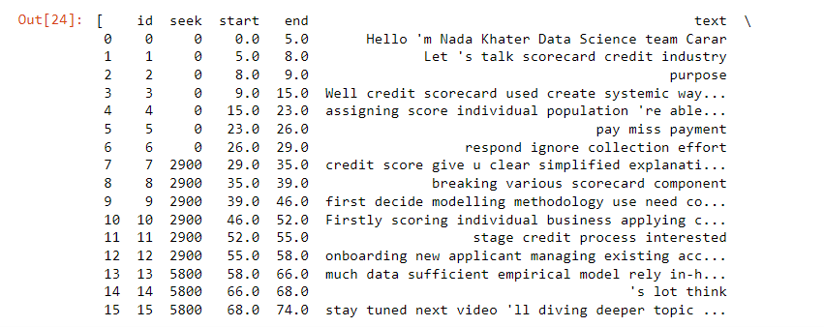
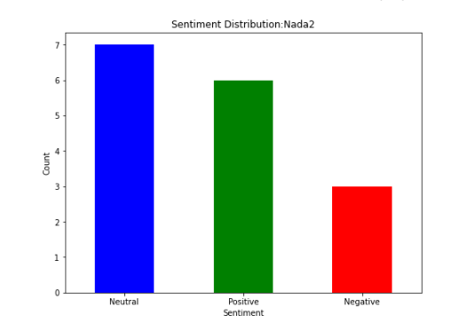
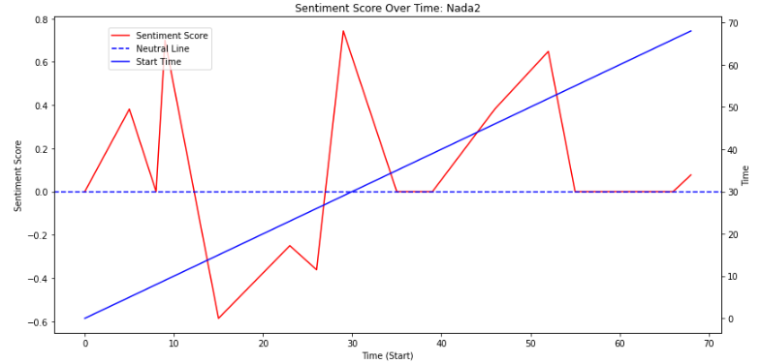

3. Facial Emotion Recognition and Sentiment Analysis.
Notes:
3. Facial Emotion Recognition and Sentiment Analysis.
Apply sentiment analysis
In order to apply sentment analysis, all stop words and punctuations needs to be removed and then the text need to be scored. Using the python library Natural Language Toolkit
Based on the score outcome add another column sentiment with the sentiment weight. SentimentIntensityAnalyzer() will be used with Naive Bayes model.
Now, let's discuss the code. While I won't cover the entire code, I'll highlight important parts.
The code preprocesses spoken sentences by removing stopwords, punctuation, and performing lemmatization to prepare the text for sentiment analysis.

Slide 7

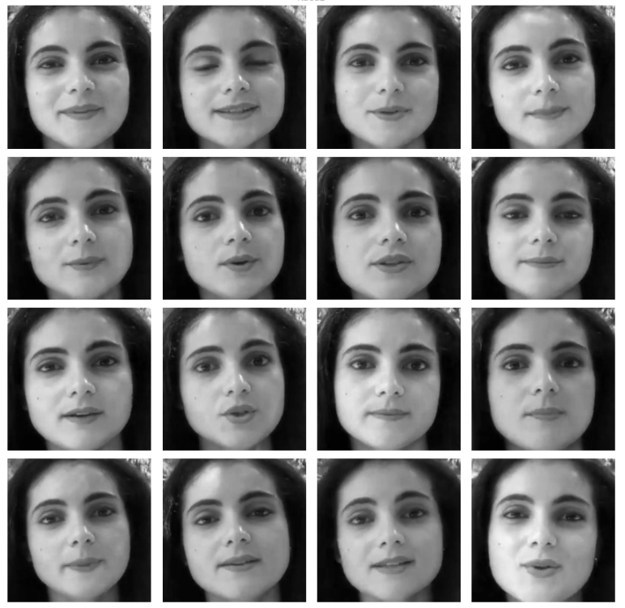


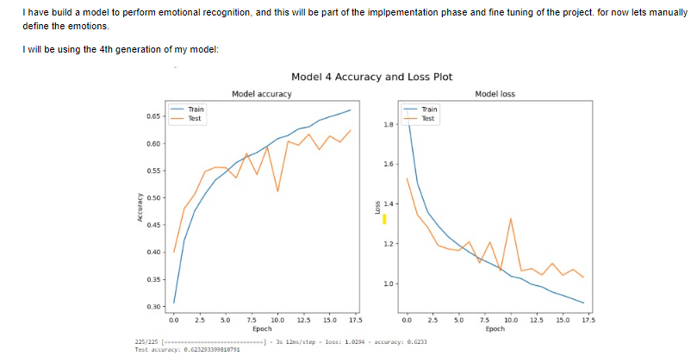
3. Facial Emotion Recognition and Sentiment Analysis.
Notes:
Verify the image at the position of the mean_value as per the extracted frame by opening the video and going to the specific frame in the video and verify the image returned corrisponds to that in the video.
To verify that all frames have been extracted and is clear the following funtion will retreive and show all the frames captured and saved to the processedData data frame
In order to apply my emotional model I need to extract the face of the person at a specific frame of the video.¶
The CascadeClassifier class is part of the OpenCV library and provides an implementation of the Haar cascades algorithm, which is a machine learning-based approach for object detection. The Haar cascades algorithm uses a set of trained classifiers to detect objects in images or video frames.
For facial emotion recognition, the code extracts frames from the video at the mean time of each spoken sentence. It applies the Haar cascades algorithm to detect faces in the frames, and the detected face regions are fed into the CNN model for emotion classification.

Slide 8
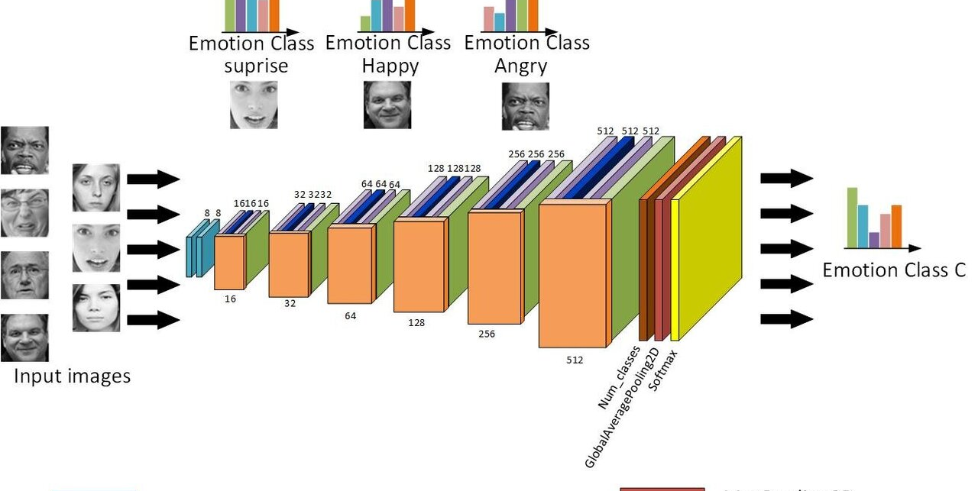
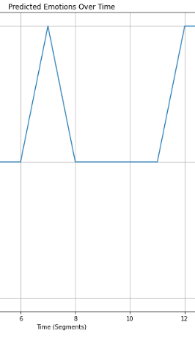
3. Facial Emotion Recognition and Sentiment Analysis.
Notes:
Verify the image at the position of the mean_value as per the extracted frame by opening the video and going to the specific frame in the video and verify the image returned corrisponds to that in the video.
To verify that all frames have been extracted and is clear the following funtion will retreive and show all the frames captured and saved to the processedData data frame
In order to apply my emotional model I need to extract the face of the person at a specific frame of the video.¶
The CascadeClassifier class is part of the OpenCV library and provides an implementation of the Haar cascades algorithm, which is a machine learning-based approach for object detection. The Haar cascades algorithm uses a set of trained classifiers to detect objects in images or video frames.

Slide 9
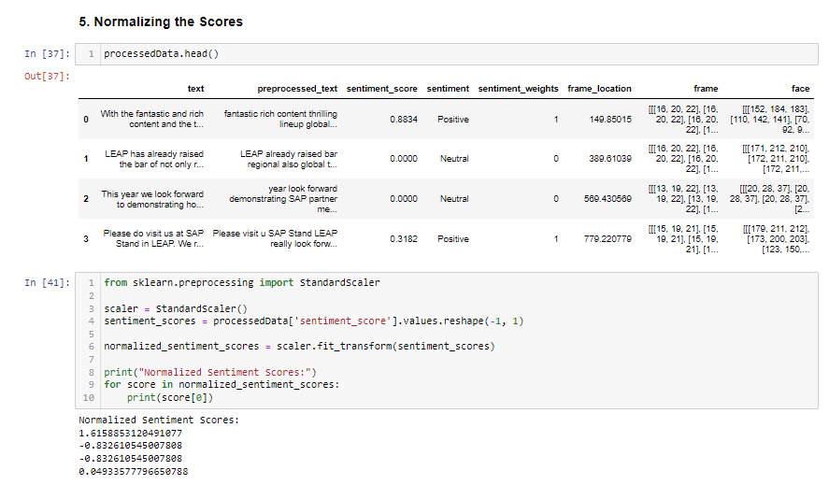
4. Normalizing the Scores.
Notes:
Normalizing data brings it to a common scale, making it independent of the original units of measurement. This is crucial when features have different scales. In sentiment analysis or emotion recognition, scores may come from different sources or algorithms and can have varying scales. Normalization ensures that these scores can be compared directly.
As I have scores from -1 to 1 for Sentiment analysis and -3 to 3 for Emotional prediction .
Normalized data is often easier to visualize. For instance, when plotting data, normalized values are more likely to fit within standard plotting ranges.

Slide 10
5. Determining Weights or Importance.
Notes:
2. Collecting and Pre-processing Data.

Slide 11
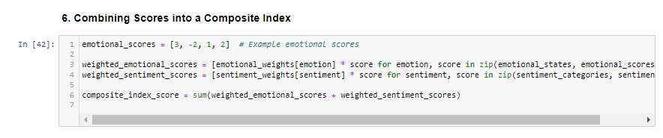
6. Combining Scores into a Composite Index.
Notes:
Combining scores into a composite index is a process where multiple individual scores or metrics are aggregated or combined into a single value or index. This composite index can provide a summarized view of the underlying data and allow for easier comparison or analysis. It allows for weighted aggregation, where you can assign different levels of importance or weights to each individual score before combining them. This is useful when some scores are considered more significant than others in the composite index.

Slide 12
7. Validation of the Index Score.
Notes:
This involves testing the reliability and validity of the index score to ensure that it accurately reflects the emotional and sentiment responses of individuals. Validation can be done through statistical analysis, sensitivity testing, or expert review

Slide 13
Thank you
Notes:
Thank you for watching this overview of my project prototype.
I hope you gained a better understanding of how my solution analyzes emotional dynamics in video conferencing calls. I am excited about the potential of this project and look forward to its future development.

